Slide 1
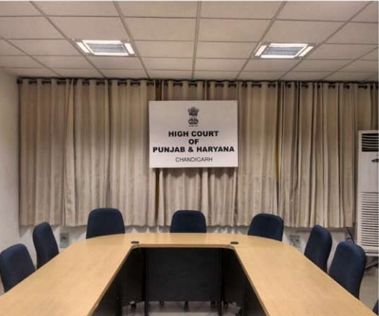
Use of Video Conferencing in JUDICIAL ADMINISTRATION

Slide 2
Modes of Interactions
Video conferencing is the next best thing to a face to face meeting.
Face to face.
Video Conferencing
Email.
Fax.
Telephone.
Online Chat.
.

Slide 3
USE OF Video Conferencing in JUDICIAL ADMINISTRATION
Securing presence of undertrials for remand.
For recording Evidence of
Expert witnesses i.e. doctors
Judicial officers
NRI or witnesses whose presence cannot be secured.
Presence of accused for trial or for recording of Statement u/s 313 Cr.P.C. where accused is lodged in jail and his movement is restricted due to security concerns.
Interviews of Judicial officers for Promotions.
Training.
Project Monitoring.
Meetings between jail inmates and their family members.
Administrative Meetings

Slide 4
Validity OF VIDEO CONFERENCING
State of Maharashtra Vs. Dr. Praful B. Desai, 2003 (4) SCC 601
Recording of evidence through VC was held legal
Basavaraj R. Patil Vs. State of Karnataka, 2000 (8) SCC 740.
Presence of accused through VC was held to proper for proceedings in Criminal trials
Amitabh Bagchi Vs. Ena Bagchi, 2005 AIR Cal. 11
State of Punjab Vs. Mohinder Singh, CRM No. 18934 of 2013 in MRC No. 8 of 2007 D.O. 21.08.2013. 2013 (4) RCR
Procedure as to how VC is to be conducted to be laid down

Slide 5
Since January, 2015, 62,000 under-trials have put in appearance in court through Video Conferencing.
Evidence of Judicial Officers is being recorded through VC only. Evidence in person require special permission and generally given for exceptional reasons.
Evidence of 2000 witnesses (Majority of them were doctors) was recorded through VC.
All interviews for promotions have been conducted through VC.
VC used extensively for training / administrative meetings and project monitoring

Slide 6
Video Conferencing Facility at PGIMER and other Hospitals of Punjab, Haryana and UT Chandigarh
PGIMER, Chandigarh was getting 4000 summons which was causing strain upon the resources of the institute in view of the large inflow of patients viz-a-viz the availability of Doctors.
Now 70% of summons are being complied at first instance and evidence of doctor is recorded through VC.
Directions on Judicial side to examine doctors through VC where ever feasible in first instance were issued.

Slide 7
USE OF VC FOR MEDIATION AND LEGAL AID
Mediation and Legal Aid Monitoring System
Software to monitor Legal Aid has been developed so as to monitor the Legal Aid process which is available using Mobile Application interface.
This specific software in conjunction with software video conferencing provides a new paradigm in the process of Mediation and Legal Aid.

Slide 8
ADVANTAGES OF Video Conferencing?
Cost effective - Save money.
Adds Manpower - Save Time
Build relationships.
Has advantages of “face to face” communication.
Avoid travels.
Teach.
Enhance monitoring.
Reduces footfall in courts thereby reducing pressure on infrastructure.

Slide 9
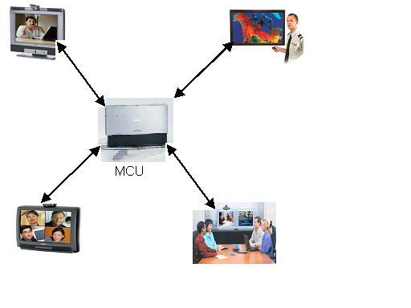
MODES OF VIDEO CONFERENCING
Point-to-Point
A videoconference that connects two locations
Multi-point
A videoc onference that connects more than two locations through a Multi-point Control Unit (MCU )

Slide 10
Types of Video Conferencing
Dedicated Video Conferencing Suites
Special hardware required
Dedicated Communication links such as ISDN
Drawbacks :- Costly
Desktop Video Conferencing
Webcams & Multimedia Phones required
Internet Connection that allows multimedia communication
Drawbacks :- Bandwidth & Proxy limitations
Mobile Video Conferencing
Just a Mobile with 3G services
Drawbacks:- Low quality

Slide 11
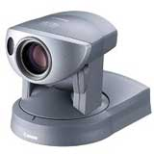
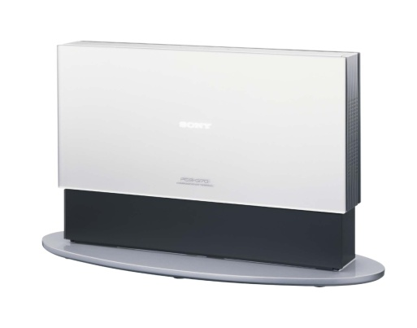
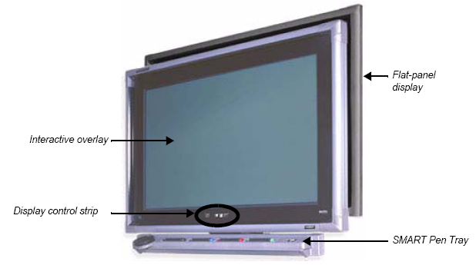
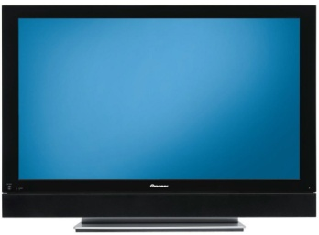
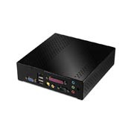
COMPONENTS OF A HARDWARE VIDEO CONFERENCING
Camera
Codec
interactive
whiteboards
Display Devices
Streaming & Archiving
Equipment
Microphone

Slide 12
COMPONENTS OF A SOFTWARE VIDEO CONFERENCING
Camera
Computer
interactive
whiteboards
Display Devices
Streaming & Archiving
Equipment
Microphone

Slide 13
Soft VC | Hardware VC
Chaep and easily accessible. | Expensive solution
Can be installed on PC, Mobile ,Laptop and i-pad – No extra cost in case of multimedia computers with camara | Hadware VC require dedicated equipments
Most of video conferencing software are designed for person-to-person meetings | Hadware VC systems are designed for rooms-to-room meetings and conferences
Workable quality | Superior quality

Slide 14
OTHER REQUIREMENTS
HARWARE – IP VC equipments
Connectivity
MCU for multiple VC’s
Software based VC equipments
Connectivity
Software based Authentication server

Slide 15
OPTIONAL ACCESSORIES
Data Solution Box
Streaming / Archiving Equipment
Interactive Whiteboard
LCD Projector & Laptop
DVR
LCD Projector & Laptop :A projector using LCD technology and small portable computer.
Interactive Whiteboard : Using a Interactive whiteboard recorder, notes and drawings on a whiteboard can be electronically converted and then transferred in real time to remote sites to be displayed on a screen.
Data Solutions Box: Transfer screen shots in XGA resolution from your PC to remote sites through a network or an ISDN line.
Streaming / Archiving : An equipment for streaming / archiving the lectures/interviews/seminars etc.

Slide 16
A TYPICAL BOARD ROOM SET-UP
Components
Video conferencing Unit
LCD TV 42” with panel speakers
External (tabletop microphones)

Slide 17
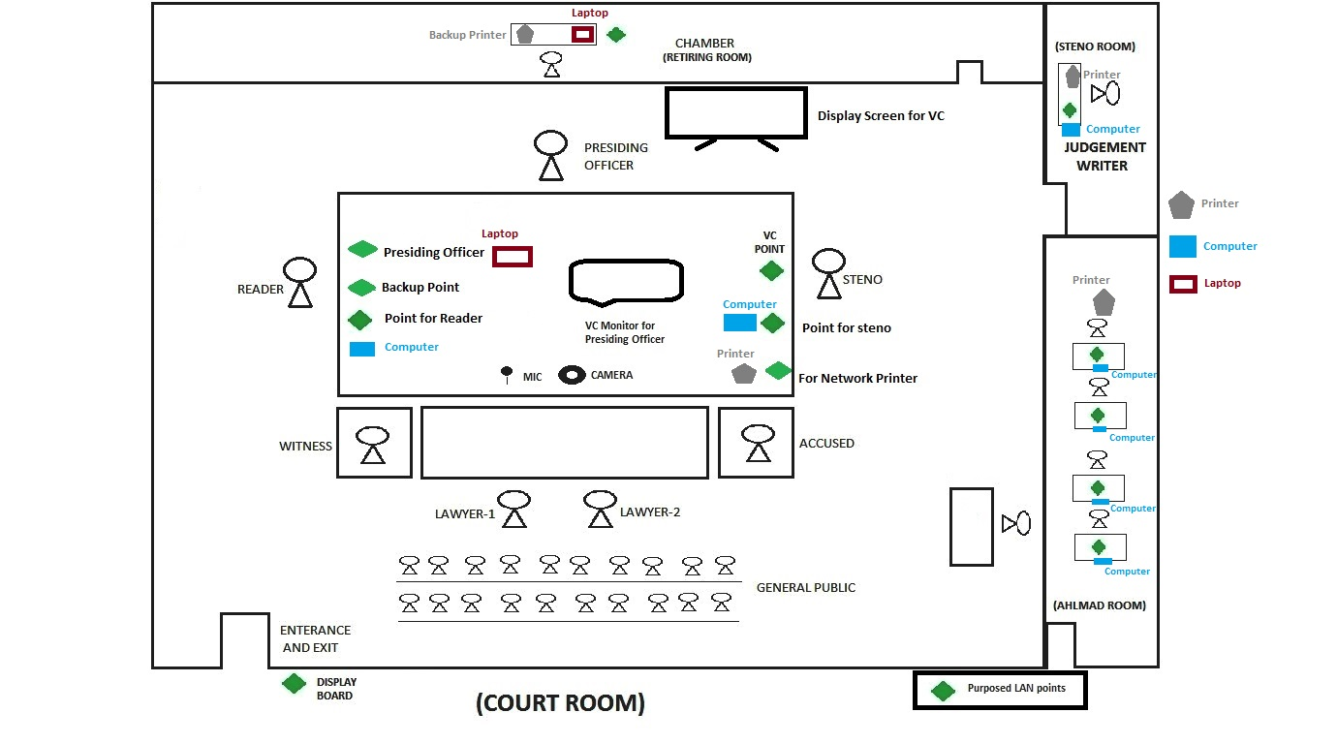
A TYPICAL COURT ROOM SET-UP

Slide 18
Software vc components
S.NO | EQUIPMENT
1 | USB BASED HD PTZ CAMERA
2 | HDMI CABLE (10 METERS FOR EACH SITE)
3 | BLUETOOTH/WIRELESS ENABLED SPEAKER CUM MICROPHONES
4 | 40" LED TV / MONITOR
5 | 21.5 " PC WITH UBUNTU LINUX OS (ALL IN ONE NON TOUCH)
6 | UPS 1KVA WITH 60 MINUTES BACKUP
7 | DISTRTICT CLUSTER WITH 100 USERS, 10 SITE MULTIPOINT, 5 USER POINT TO POINT(8 UNITS IN HARYANA)
8 | STATE / CENTRAL MCU/AUTHENTICATION SERVER

Slide 19
Hardware vc : tentative COST
SR.NO | DESCRIPTION | QTY | RATE PER UNIT
1 | VC END POINT MAKE | 1 | 345340
2 | LCD 40/42” | 1 | 64481
3 | UPS 1 KVA | 1 | 40353
4 | LAYING OF UTP (MAX 100 MTS. ,AS PER REQUIREMENT) | 1 | 41300
5 | PROJECT MANAGEMENT FOR EACH SITE FOR 5 YEARS | 1 | 29375
6 | TRAINING COST EACH SITE | 1 | 433
A | HARDWARE COST FOR VC EQUIPMENT AT EACH SITE |  | 521282
*Budgetary Estimate provided by HARTRON for installation of Video Conferencing Facility dated 23.10.2013.

Slide 20
Software based vc : tentative COST
S.NO | NAME OF ITEM | UNIT PRICE OF THE ITEM IN RS. | INSTALLATION CHARGES IN RS.
1 | WEB BASED SOFTWARE VIDEOCONFERENCING INFRASTRUCTURE | 1470367.01 | 25197.45
2 | DISTRICT CLUSTER WITH 100 USERS, 10 MULTIPOINT, 5 USER POINT-TO-POINT FACILITY | 808361.22 | 7559.23
3 | STATE CLUSTER WITH 1000 USERS, 50 MULTIPOINT, 25 SITES POINT-TO-POINT CONNECTIVITY INCLUDING 2 NOS. H323/SIP VC ENDPOINT AND 2 NOS. OF RECORDING | 3506354.78 | 22067.15
4 | ADDITIONAL HARDWARE / SOFTWARE REQUIRED FOR AUGMENTING 5 NOS. OF CONCURRENT RECORDING AT HD RESOLUTION | 651733.23 | 12275.03
5 | 1080P HD VC EQUIPMENT | 397919.83 | 3166.16
6 | 55” LED TV / MONITOR | 86376.00 | 1980.00

Slide 21
Software based vc : tentative COST
Sr. No. | Hardware equipment | Price including all taxes | Equipments for soft VC | Price in Rupees
1. | High end HF1080P60 VC system working over | `4,95,828/- | Bluetooth wireless speaker | 8,391/-
2. | License for VC with 1+3 | `30,466/- | HDMI Cable 10 Meters | 1,130/-
3. | 40” HD LED | `34,790/- | 21.5” PC with UBUNTU (All in one) | 44,493/-
4. | UPS KVA | `31,461/- | PTZ Camera | 11,236/-
5. |  |  | 40” HD LED | 34,790/-
6. |  |  | UPS KVA | 31,461/-
 | Total | 592545 |  | 1,31,501/-

Slide 22
How VC was MADE SUCCESSFULL
Management of resources
Monitoring
Application of mobile technology
Active Participation of Nodal officers from Courts : Jails : Hospitals

Slide 23
Management of Resources
Human Resource required :
Appointment of Coordination Committees at State and District level along with Nodal officers for each participating unit who are responsible for coordinating with other participating department is first step.
Head of Institutions / Assisting Staff needs to be mapped at two levels
Nodal officers needs to be appointed at District and Taluka level

Slide 24
State Level Coordination Committee

Slide 25
Head of Institutions /Assisting Staff at State Level
CPC – Judicial department
DGP Prisons – Jail Department
PS to Director Health Services / or any other person nominated by Director Health Services
Director Health Services – Health Department
System Officer – High Court / or any other person nominated by CPC
PS to DGP / or any other person nominated by DGP

Slide 26
District Level Coordination Committee
D&SJ
Nodal officer
District Computer Committee
CMO
Jail Supdt

Slide 27
Head of Institutions /Assisting Staff at District level
District Judge – Judicial department & Nodal officer of District Computer Committee
Court Suprentendent or Court manager / or any other person nominated by D&SJ
Jail Superintendent – Jail Department
CMO (Chief Medical Officer) – Health Department
PS to CMO / or any other person nominated by Director Health Services
PS to Jail Sperintendent / or any other person nominated by DGP Jail Sperintendent

Slide 28
Nodal officers
Courts
Jails
Hospital
At District Level

Slide 29
Nodal officers
At District Level
Courts
System officer or in absence of SO senior most System Assistant / or any other official nominated by D&SJ
Hospital
Person nominated by CMO
Jails
Person nominated by Jail Superintendent
Nodal officer appointed for court has list of Judicial officers & readers and Stenos attached to each court along with mobile No. and email for effective communication.
Nodal officer appointed for hospital shall have list of all doctors & staff attached to doctor along with mobile No. and email for effective communication.

Slide 30
Sharing of Information
Sharing of List of head of Institution with contact details along with contact details of assisting staff to Head of Institution
Name | Place | Institution | Mobile No. | email | Office land-line | Name of assisting staff | Mobile | Email | Landline office

Slide 31
Sharing of List of Nodal officers with Name, Place / Institution, Mobile No., email, office land-line
Name | Place | Institution | Mobile No. | email | Office land-line
These lists be updated on weekly basis.
If there is any change same needs to be communicated to all the Nodal officers / Institute heads / assisting staff.

Slide 32
Communication Tools deployed
Google Sheet
For sharing of summons, date of evidence / appearance, time, name of case, Case No. Name of witness / accused and Remarks for successful or failed VC
Sorting on Date fixed, Time of VC, District

Slide 33
Date fixed | Time of VC | Name of Witness | Institution of witness | Name of accused | Jail in which lodged | Purpose | Case No. | Case title | Distt. | Court | VC Status | Remarks
1.1.15 | 14.00 | Dr. Ram | PGI | Ramesh | Karnal | Evidence | SC 12 of 2013 | State Vs. A | Sonipat | D&SJ - Sh. A.K. | Done | Sound quality from Jail was not good
1.1.15 | 11.00 | Dr. Raj | DH, Ambala | LOK | Gurgoan | Appearance | SC 12 of 2013 | State Vs. A | Sonipat | D&SJ Sh. A.K. | Done | Sound quality from Jail was not good

Slide 34
Whatsapp & Email
Group of Nodal officers to communicate tentative date and time.
SMS & Mobile
To notify last minutes changes.

Slide 35
HOW IT WORKED
Monitoring System
Monthly reports regarding Summons issued / received along with reasons as to why VC was not conducted / problems if any faced in conduct of VC.
Meetings at State level / District Level depending on nature of problem being faced as and when any issue arises and not resolved within 7 days.
Inviting suggestions from nodal officers as to how problem can be resolved.

Slide 36
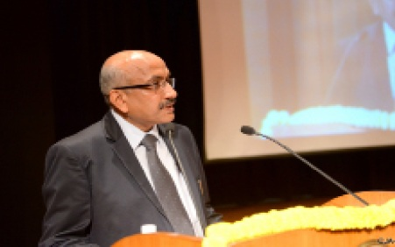
Thank you

